Slide 1
Junior/Senior Parent Night College and Financial Aid Presentation
November 11, 2024

Slide 2
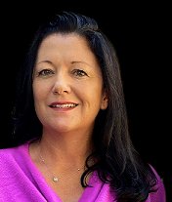
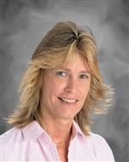
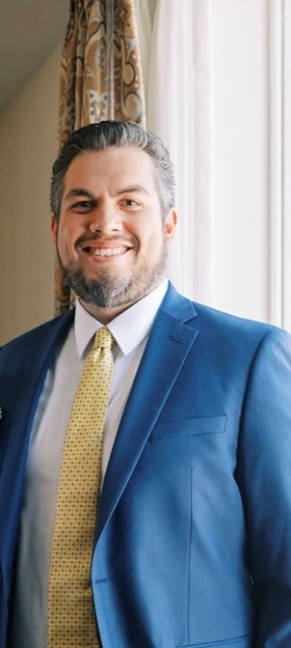
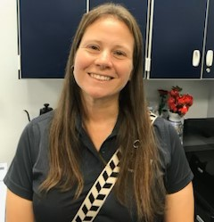
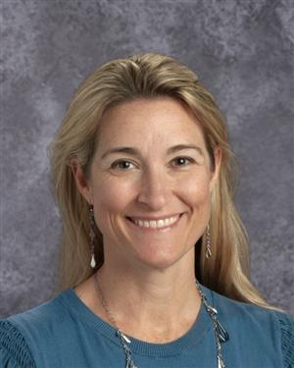
Meet your Administrative Team
Mrs. Patterson: Principal
Ms. Berry: AP 12th grade & 10th grade A-L
Mr. Beam: AP 11th grade & 10th grade M-Z
Mrs. Sadlowski: AP Medical Magnet & 9th grade A-L
Mrs. Striblen: AP IB & 9th grade M-Z

Slide 3
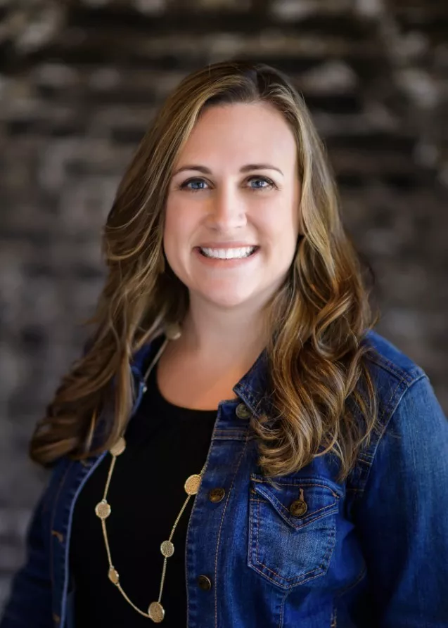
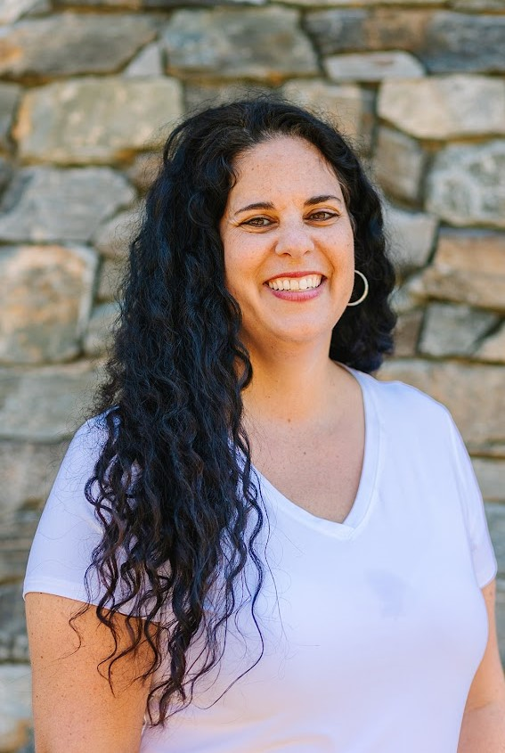
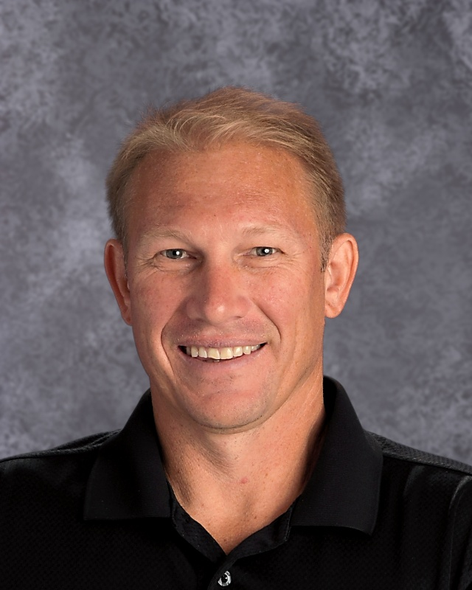
Your School Counselors are here to help!
Program | Counselor
I.B.: | Amber Shepherd-Thompson
C.W.M.P.: | Erika Picard
University Last Names A-G | Elizabeth Ryczek
University Last Names H-O | Tim Papp
University Last Names P-Z | Amanda Madej

Slide 4
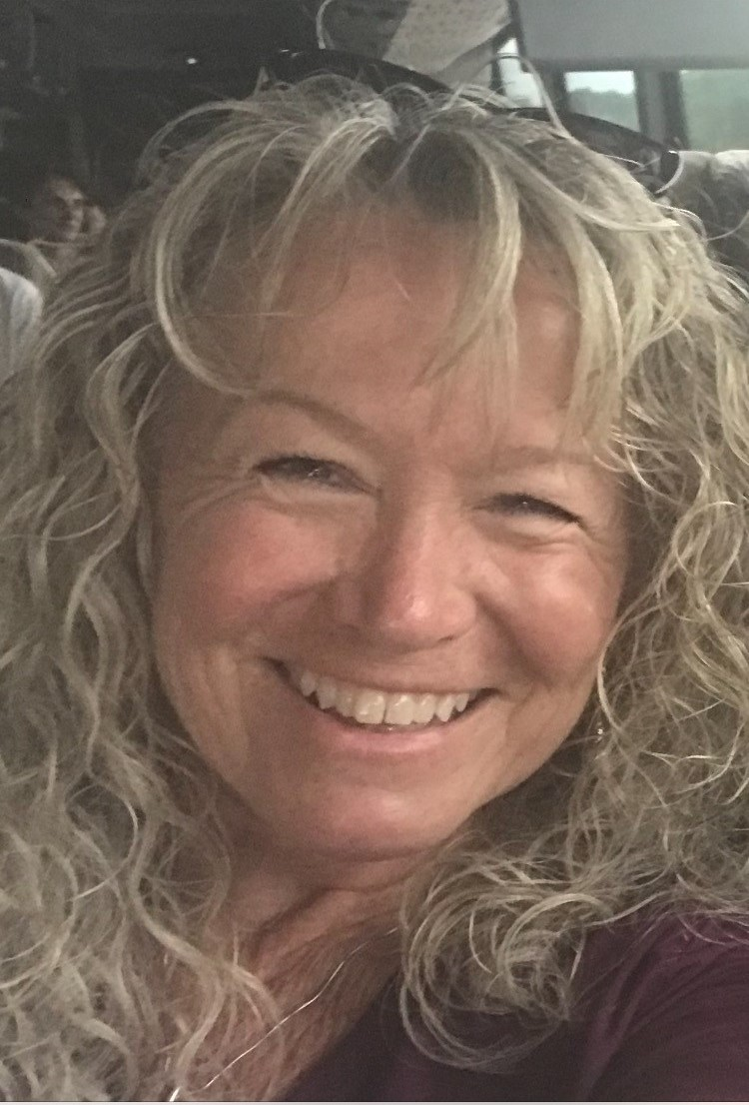
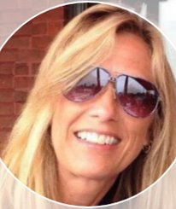
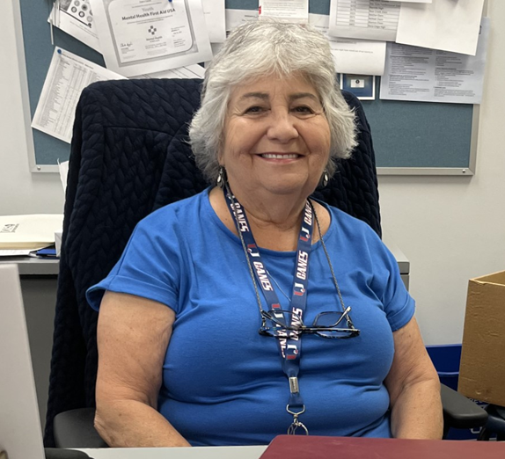
Your 11th Grade Secretaries
Ms. Marino – Medical Magnet
Ms. Marsh– IB
Ms. May – 11th Grade University

Slide 5
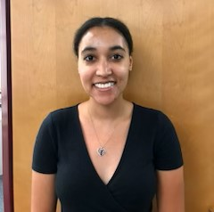
Your 12th Grade Secretaries
Ms. Marino – Medical Magnet
Ms. Marsh– IB
Ms. Bryant – 12th Grade University

Slide 6
Agenda
Financial Aid, FAFSA, Bright Futures, Scholarships- Brooke Pair
Jr/Sr information
Grad Requirements
College Admissions
Resources
CWMP
Medical Hours
Booster Club updates
This Photo by Unknown Author is licensed under CC BY-SA

Slide 7
2024-2025
FINANCIAL AID PRESENTATION
Brooke Pair, Financial Aid Counselor
pairb@pcsb.org
(727)-588-6013

Slide 8
Overview
01
What is financial aid?
02
Where to find scholarships and financial aid information
03
Bright Futures Scholarship
04
Free Application for Federal Student Aid (FAFSA)
05
Questions?

Slide 9
What is Financial Aid?
Financial Aid is money
to help you pay for college
Types of Financial Aid
Grants
Doesn’t have to be repaid
Scholarships
Usually based on merit, talent or particular area of study
Work-Study Jobs
Allows you to earn money to pay for school by working part-time
Loans
Money you borrow and must pay back with interest

Slide 10
01
www.pcsb.org/financialaid
02
Scholarship Opportunities
03
Bright Futures information including information about the process for earning volunteer or work hours
Links to our FAFSA webpage, Pinellas Education Foundation and Scholarship Search Engines
04

Slide 11
WWW.PCSB.ORG/FINANCIALAID

Slide 12
Scholarship Opportunities*
01
I will note the date that it was last updated.
02
When you open the document, new scholarships will be noted with NEW!
03
Take note of the grade level and deadline to apply.
04
The requirements will show you details of the scholarship including how to apply--online or paper form.
*Scholarship information will also be uploaded to Xello.

Slide 13
Colleges & Univerisities
Check websites about when/how to apply
Local Scholarships
Might be sponsored by local organizations, employers, clubs, education foundations.
Where to Find Scholarships
State Scholarships
Most require that you attend school in-state. Example Bright Futures
National Scholarships
Open to students across the country. Typically, they are very competitive
and high dollar amounts.

Slide 14
PINELLAS EDUCATION FOUNDATION TRADITIONAL SENIOR SCHOLARSHIP
www.pinellaseducation.org
Opens September 30th
Online Application
PEF Offers Additional Scholarships
Over 100 different scholarships to more than 250 high school seniors throughout Pinellas County
Scholarship criteria varies from music & drama to science & math and even sports
Pinellas Education also offers other scholarships such as Take Stock in Children and Walker’s Rising Stars

Slide 15
Florida State Scholarship and Grant Website
https://www.floridastudentfinancialaidsg.org
Fact Sheets for each grant
& scholarship
Latest legislative information
Bright Futures Handbook
Florida Financial Aid Application

Slide 16
Florida Bright Futures Scholarship Program
Awarded to every student in the
state of Florida who meets all
requirements.
Requires that students complete
the Florida Financial Aid
Application (Opens Oct. 1)
Four levels of
Scholarships

Slide 17
General
Requirements for
Bright Futures
Be a Florida resident and U.S. citizen or eligible non-citizen as determine by the student’s postsecondary institution.
Complete the FFAA no later than August 31 after
high school graduation.
Earn a standard Florida high school diploma, or its equivalent.
Not have been found guilty of, or pled nolo contendre to a felony charge.
Be accepted by, and enroll in a degree or certificate program at, an eligible Florida public or independent postsecondary institution.
Be enrolled for at least six non-remedial semester credit hours(or the equivalent in quarter or clock hour) per term.
If not funded in the academic year immediately following high school graduation, apply within five years of high school graduation to have your award reinstated.

Slide 18
Florida Academic Scholarship (FAS) &
Florida Medallion Scholarship (FMS) Overview
Complete the required coursework;
Achieve the required minimum high school grade point average (GPA);
Achieve the required minimum score on the ACT, SAT, or CLT college entrance exam;
Complete the required number of volunteer or work hours (or required number of a combination of both)

Slide 19
Florida Academic & Medallion- Coursework
Complete the required high school course work:
16 High School Course Credits
4- English (three must include substantial writing)
4- Mathematics (at or above the Algebra 1 level)
3- Natural Sciences (two must have substantial laboratory)
3- Social Studies
2- World Languages (sequential, same language)
Coursework aligns with the State University System (SUS)
admissions requirements.

Slide 20
Florida Academic & Medallion- Grade Point Average (GPA)
Achieve the required minimum GPA:
High School Weighted GPA
FAS- 3.50
FMS- 3.00
Unrounded weighted GPA in the 16 college-prep courses listed on the previous slide
AP, Pre-IB, IB, Honors, Pre-AICE, AICE and academic Dual Enrollment are weighted .25 per semester course or .50 per year course

Slide 21
Florida Academic & Medallion-
College Entrance Exams
Florida Academic Scholarship (FAS)
Florida Medallion Scholarship (FMS)
2024-25 Graduates: 29 25
2025-26 Graduates: 29 24
ACT
OR
OR
2024-25 Graduates: 96 84
2025-26 Graduates: 95 82
CLT
OR
OR
2024-25 Graduates: 1340 1210
2025-26 Graduates: 1330 1190
SAT
These scores are for students graduating during the 2024-25 and 2025-26 school years.
OSFA will announce the scores for those graduating during the 2026-27 school year
during the summer of 2025.

Slide 22
Florida Academic and Florida Medallion- College Entrance Exams
The ACT®, CLT®, or SAT® exams may be taken an unlimited number of times through August 31 of the high school graduation year (or through January 31 for mid-year graduates*).
Students will be evaluated based on official test scores from the FDOE repository. To ensure OSFA obtains official test scores:
Ensure demographics on your test registration and high school transcript match; and
*Mid-Year graduates are those students who:
• Graduate mid-way through the 2024-25 year (September 1, 2024, through January 31, 2025);
• File the Florida Financial Aid Application no later than December 31, 2024; and
• Plan to enroll and receive funding at a postsecondary institution in spring 2025.
Request your official single sitting test scores be sent to one of Florida’s public colleges or state universities. CLT & ACT can be sent directly to Bright Futures.

Slide 23
Florida Academic & Medallion-
Volunteer Service and
Paid Work Hours
Combination
of Service
and
Paid Work Hours
FAS 100 Hours
FMS 100 Hours
Service Hours
FAS 100 Hours
FMS 75 Hours
Paid Work Hours
FAS 100 Hours
FMS 100 Hours

Slide 24
Other Ways to Qualify
Students who have demonstrated academic merit through a recognition program may be eligible for Bright Futures without having to meet one or
more of the requirements.
National Merit Finalist and Scholars
National Hispanic Scholars
AICE Diploma
IB Diploma
If students earn any of the above, they do need to meet the service or paid work hours requirement.

Slide 25
Florida Gold Seal CAPE Scholarship (GSC)
Initial Eligibility Requirements
1. Earn a minimum of 5 postsecondary credit hours through eligible CAPE industry certifications that articulate for
college credit.
2. Complete at least 30 volunteer service hours, 100 paid work hours, or a combination that equals a
minimum of 100 total hours.

Slide 26
Scholarship Restrictions for Florida Gold Seal CAPE
•Until a student has earned an eligible associate degree, Gold Seal CAPE (GSC) scholarships may only be used at postsecondary institutions that offer an applied technology diploma, technical degree education program (associate in applied science or associate in science), or a career certificate program.
•Upon completion of an eligible associate degree program, a GSC Scholar may also receive an award for a maximum of 60 credit hours toward an eligible baccalaureate degree.

Slide 27
Florida Gold Seal Vocational Scholarship (GSV) Initial Eligibility Requirements
Achieve the required weighted 3.0 GPA
in the non-elective high school courses,
01
Take at least 3 full credits in a single
Career and Technical Education program,
02
03
Achieve the required minimum 3.5
unweighted GPA in the career education courses,
Complete 30 service hours, 100 work
hours, or a combination that equals a
minimum of 100 hours and
04
05
Achieve the required minimum scores on one of the college entrance exams outlined on next slide

Slide 28
ACT
Reading 19
English 17
Math 19
Florida Gold Seal Vocational Scholarship-
College Entrance Exams
OR
SAT (Prior to March 1, 2024)
Reading Test 24
Writing & Language Test 25
Math Test 24
SAT (March 1, 2024 & After)
Critical Reading: 490 Mathematics: 480
OR
PERT
Reading 106
Writing 103
Math 114

Slide 29
Scholarship Restrictions for Florida Gold Seal Vocational Scholarship
GSV may only be used at postsecondary institutions that offer an applied technology diploma, technical degree education program (associate in applied science or associate in science), or a career certificate program.

Slide 30
Bright Futures
Award Amounts
Florida Academic
Florida Medallion
Gold Seal Vocational & CAPE
100 % Tuition and Fee
75% Tuition and Fees at
75% Tuition and Fees at a public institution; 100% Tuition & Fees for student working on Associate Degree at a Florida Public College
100 % Tuition and Fees at a public institution
Fixed cost per hour based on award level, institution type & credit type
Example: Semester Hour $39-48
Non-public Florida institutions will receive a comparable amount.

Slide 31
Bright Futures Evaluations
Beginning in November, high school students will have access to view their Bright Futures evaluation in Xello, our online college & career platform.

Slide 32
What is the FAFSA?
Free Application for Federal Student Aid (FAFSA)
Snapshot of your family’s financial picture
Helps determine your eligibility for federal and state aid as well as some college-base grants and scholarships
That FAFSA is free!
Normally opens October 1st but is delayed again this year and won’t open until Dec. 1st
When you are ready, go to www.studentaid.gov to get started.

Slide 33
The FAFSA has changed!
A Better FAFSA,
A Better Future
The FAFSA Simplification Act was ratified in August 2022.
The purpose of the act is to streamline the FAFSA with three main goals:
Expand eligibility for federal financial aid,
Reduce barriers for certain student populations,
A better user experience when completing the FAFSA

Slide 34
What is an FSA ID?
Federal Student Aid Identification
Use to provide your electronic signature
Getting ready- Creating an FSA ID
Create both a Username and Password
Once created, it will be used each year.

Slide 35
Who Needs an FSA ID?
The student who is applying
If the student is dependent, one or both parents will need an FSA ID
When ready to create your ID, go to studentaid.gov and choose Create Account.
Will need personal email account (cannot use same email as parent)
Parents who already have FSA ID will use the same one and cannot create a new one.

Slide 36
FAFSA Basics
Parents without SSN can now create an FSA ID.
The FAFSA is based on “Prior Prior” tax information so you will be providing tax information and income from 2023 on the 2025-2026 FAFSA.
You must report any income earned in 2023 even if you didn’t file a tax return. This can be entered manually on the form.
Each contributor must provide consent to retrieve federal tax information for the FAFSA.
If consent is not provided, the student will be ineligible for Federal Student Aid.
Students answer questions on the FAFSA to determine if they will be dependent or independent on the FAFSA
Dependent students must provide parental information.
Independent students do not provide parental information.
Students can list up to 20 colleges at a time on their FAFSA.

Slide 37
Need Help with Completing the FAFSA?
PCS will have a FAFSA Kickoff Event in early
January 2025 TBD
All traditional high schools will be offering FAFSA
Completion events during second semester
All events will be posted at www.pcsb.org/FAFSA

Slide 38
Graduation Requirements

Slide 39
Graduation Requirements
Credits
24 credits, specific subject area requirements
GPA
2.0 unweighted cumulative GPA
Testing
Pass FAST ELA PM3 or earn concordant
Pass Alg 1 EOC or earn concordant

Slide 40
Testing Requirements
Pass FAST ELA PM3 (level 3) OR Concordant on any of following:
ACT (Avg of 18 on Reading and English)
SAT (480 on EBRW)
CLT (36 on Verbal Reasoning and Grammar/Writing)
Pass Alg 1 EOC (level 3) OR Concordant on any of following:
ACT (16 Math)
SAT (420 Math)
PSAT (430 Math)
CLT (11 Quantitative Reasoning)

Slide 41
Graduation Requirements
English
4 credits
Math
4 credits, must include Algebra 1 (1.0) and Geometry (1.0)
Science
3 credits, must include Biology (1.0)
Social Studies
American Government (0.5) Economics with Financial Literacy (0.5)
US History (1.0) World History (1.0)
This Photo by Unknown Author is licensed under CC BY

Slide 42
Graduation Requirements
Performing/Fine Arts/Career Techincal Education
1 credit in fine/performing or approved CTE
HOPE (Health Opportunities Through Physical Education)

Slide 43
IB Graduation Requirements
English
4 credits
Math
4 credits, must include Algebra 1 (1.0) and Geometry (1.0)
Science
4 credits, must include Biology (1.0)
World Lang.
4 credits
Social Studies
US History (1.0)
World History (1.0)
History of the Americas(1.0)
Contemporary History (1.0_
CAS
EE
TOK

Slide 44
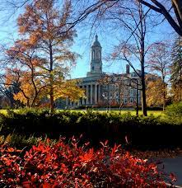
4 Year College/University Requirements
In addition to HS Grad requirements, you must take:
Algebra 2
2 or 3 years of foreign language (consecutive, same language)
Recommendation:
take foreign language throughout HS
take advanced coursework (AP, DE, AICE, Honors)
take additional math and science courses (as advanced as you can)
Notes:
Florida schools want to see 3.5 years of foreign language!

Slide 45
Online registration
https://collegereadiness.collegeboard.org/sat
Cost is $68
Additional fee for late registration
2 Sections: Evidence Based Reading & Writing and Math
Test code center # is 100254
Will offer a FREE SAT School Day test for ALL Juniors in March; Seniors took on Oct 22nd

Slide 46
Online registration
www.actstudent.org
Cost is $69 for the ACT (No Writing)
$94.00 for the ACT Plus Writing
Additional fee for late registration
4 sections: Reading, English, Math, Science (going optional 2025)
Test code center # is 100254.

Slide 47
SAT vs ACT
SAT is fully digital (and adaptive), ACT is going digital but still have choice for paper/pencil (for now)
Some colleges are test optional
Some say ACT caters a bit towards general academic strengths
SAT gives slightly more time per question than ACT.
Neither penalizes for wrong answers, so you should always give your best guess!
Neither measure intelligence – just how well you do at taking this company’s test

Slide 48
SAT vs ACT
Sign ups for both are done through the testing agency.
Fee Waivers are available for students on free/reduced lunch: 2 waivers each lifetime
Test Blind: these schools won’t look at test scores AT ALL.
Test Optional: consider test scores. Check the middle 50% range of scores… if you scored in this range or higher, then submit.
Superscoring: taking the highest score of each section to total your highest composite scores

Slide 49
College admissions

Slide 50
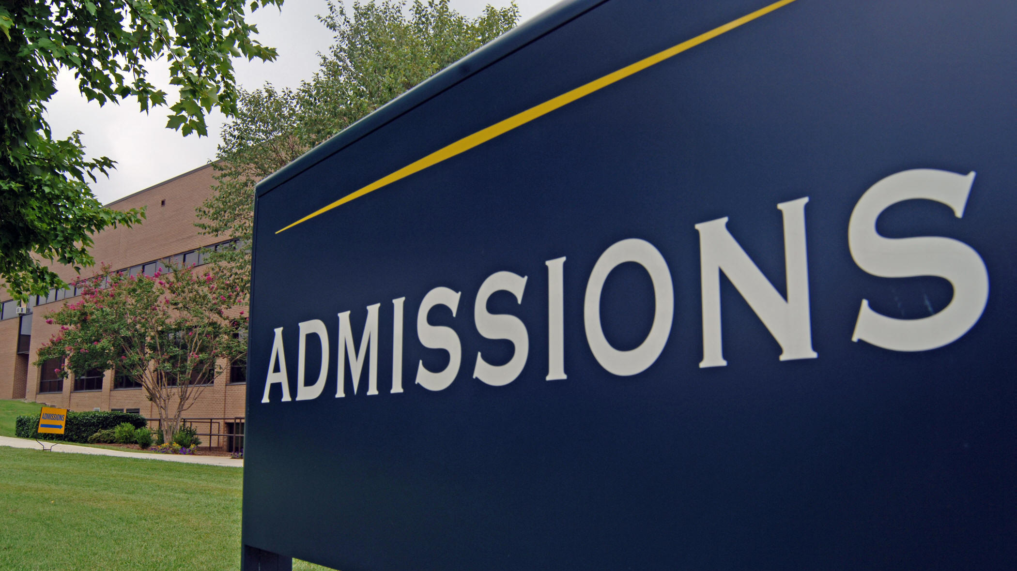
College Admissions
What should your child be doing right now?
APPLYING TO COLLEGES- if senior/early grad
Researching colleges, majors, programs of interest
Visit colleges websites to determine admission requirements/deadlines
Visiting college campuses (2 days excused w/ proper documentation)
Attending college/career fairs to speak to admissions representatives
Ask teachers and counselor for recommendation letter, if required
Send SAT/ACT scores, AP scores, official transcripts once submit application

Slide 51
College Research - Where do you want to go?
Xello
Florida Shines - www.floridashines.org
Big Future Collegeboard - www.bigfuture.collegeboard.org
eCampus Tours - ecampustours.com
Admittedly - admitted.ly
Cappex - cappex.com
Chegg - chegg.com
College Raptor- collegeraptor.com
Is this college a good fit for me?
Do they have my major?
SAT?
ACT?
GPA?
LOCATION?
Is the price tag realistic?
What is their 4-year graduation rate?
What is their avg freshman retention rate?
Are there options for study abroad?
Are their students employed upon graduation?

Slide 52
College Admissions-Applications
There are various ways to apply
All students must connect Xello to Common App
If student not applying through Common App they still MUST add college to Xello college list
Step by step video for Xello/Common App linking:
https://tinyurl.com/ywb9yx2z

Slide 53
Application to do list
Submit an application online
If using Common App – have to connect CA to XELLO
Be aware of application deadlines
Early Decision
Early Action /Early Action Restrictive
Regular decision
Send your SAT/ACT scores through the testing agency website
Request/Send Transcripts
Are letters of recommendation needed?
Ask a minimum of 3 weeks before the deadline
SSAR/SPARK

Slide 54
Types of Decisions
Early Decision
a binding application to one college, non-refundable deposit, deadlines as early as October 15/November 1
Early Action
not binding, hear back from college sooner, must decide by May 1
Priority Decision
not binding, comes before regular decision, may give you priority decision on housing, scholarships
Regular Decision
deadline usually between November - May
Rolling Admission
students are accepted all year long

Slide 55
SSAR Self-reported Student Academic Record
Participating colleges/universities:
University of Tampa
Florida A & M University
Florida Atlantic University
Florida Polytechnic University
Florida State University
New College of Florida
University of North Florida
University of Florida
University of South Florida
University of West Florida
https://ssar.selfreportedtranscript.com/Login.aspx
FSU has the best help page for anything and everything to do with the SSAR:
https://admissions.fsu.edu/first-year/ssar/

Slide 56
Letters of Recommendation
Who to ask
Min 3 week notice
Invite them to Xello, etc
FERPA - waive your rights - what does this mean?
Resume

Slide 57
FERPA Under the terms of the Family Educational Rights and Privacy Act (FERPA), you can review letters of recommendation and use accompanying forms after you enroll at a postsecondary institution and only if that institution saves the documents post-enrollment.
Why should you consider waiving your right of access?
Waiving your right lets colleges know that you will never try to read your recommendations.
That in turn reassures colleges that your recommenders have provided support that is candid and truthful.

Slide 58
transcripts
What is on my transcript?
Can submit application prior to sending transcripts
Common App (must be linked to Xello)– counselor does it & free
Through applications (request through Xello) – counselor does it & free
SSAR/SPARK – YOU DO IT & FREE

Slide 59
timeline
Take a Fall SAT/ACT if needed for test scores for Nov/Jan deadlines
Attend any info workshops or meetings held at school
Narrow down college list
Begin applying to colleges
Stay organized with deadlines
Request transcripts and LORs be sent through Xello
FAFSA,
Bright Futures,
Pinellas Ed Foundation
Open now, Dec 1 (FAFSA)
Attend any financial aid workshops offered by district or local universities
Send test scores through testing agencies
Make a college decision and secure your spot by paying your deposit

Slide 60
College Admissions Resources
College and Career Center
Make appointment with Mrs. Lopez for assistance
Apply Yourself Florida Student Guide
College Application Week (Oct 21st-25th)
Counselors were available all day, every period to assist students with college applications, scholarships, financial aid, etc.
Next Stop, SPC event will occur in Spring
Free application to apply to SPC and advisors present to answer questions/guide students who plan to attend SPC after graduation

Slide 61
Resources

Slide 62
Scholarships
www.pcsb.org/financialaid
Scholarships updated monthly
www.cappex.com
www.fastweb.com
www.scholarships.com
www.tuitionfundingsources.com
www.chegg.com/scholarships
https://bigfuture.collegeboard.org/scholarship-search
www.floridastudentfinancialaidsg.org
www.mycollgedollars.com
www.scholarships.com
www.scholarshipsexperts.com
https://www.collegeraptor.com/college-guide/category/scholarships/
www.raise.me
www.highfivescholarships.com
www.Collegescholarships.org
www.unigo.com
https://myscholly.com/
https://www.niche.com/colleges/scholarships/
https://www.salliemae.com/college-planning/tools/scholarship-search/

Slide 63
FOCUS/Portal Resources
Clever
Access all programs/resources
Including virtual textbooks, programs used in class, Canvas, Naviance, Office, etc.
Xello
customizable planning portal for students and families including self-discovery assessments, goal-setting, college research tools, and career exploration resources.
Office 365
Access excel, word, powerpoint, files
Access school email through outlook (r2.d2@pcsb.org)

Slide 64
Academically researched and scientifically validated, Xello’s award-winning program puts the student at the center of their planning experience. Students document their journey as they build self-knowledge, explore post-secondary options, create plans, and continually reassess as they take in new knowledge, skills, and experiences.
Xello Introductory Videos:
https://youtu.be/yjIugQsPowI?list=PLBqDBylN16Vfb34Gs2dyNTl0oki319eAD
https://youtu.be/AAkAvFzRiVs?si=rrYisAyR1huo7Vaj
Students will complete lessons each semester in Xello to explore college and career opportunities and options.

Slide 65
Resources
Homework Help for Math
Tuesday All Math 19-131
Khan Academy- video tutorials all subject areas
https://www.khanacademy.org/
Homework Help Line
727-547-7223
Monday – Thursday 5:00pm-8:00pm
Extra Help with Teachers
By appointment or by schedule teacher provides (might be on board or syllabus)
2:05-4:05pm

Slide 66
College and career center
CCC Padlet
The College and Career Center supports students and families to access resources, explore opportunities and work collaboratively on:
Career pathway and major exploration
College exploration and match
Application development and submission
SAT/ACT preparation resources
College fair and admission events
Financial and scholarship planning
Essay preparation and review
Mrs. Sarah Lopez Room 1-154 Lopezsar@pcsb.org

Slide 67
University Student Padlet
CWMP Padlet

